Slide 1
SQL QUERY LANGUANGE

Slide 2
Structure Query Language (SQL)
Ketika seorang user ingin mendapatkan informasi dari sebuah database, ia dapat menuliskan sebuah QUERY
QUERY merupakan sebuah permintaan/perintah yang diberikan oleh user untuk memperoleh data atau informasi dengan kondisi tertentu
SQL merupakan sebuah bahasa komputer yang digunakan untuk mengakses dan memanipulasi data dengan kondisi tertentu yang ditentukan oleh user
SQL bukan sebuah algoritma!!

Slide 3
Basic SELECT Statement
SYNTAX:
SELECT * FROM <table name>;
SELECT <column name 1, column name 2, etc.>
FROM <table name>
WHERE <condition>;

Slide 4
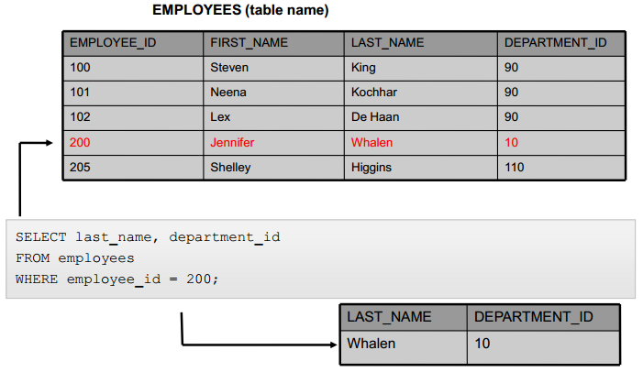
example
Instead of manually searching through each row to find the record for employee number 200, we use the following SQL statement:

Slide 5
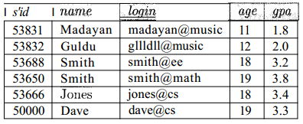
Creating and Modifying Relations Using SQL
The CREATE TABLE statement is used to define a new table
CREATE TABLE Students ( sid CHAR(20) ,
name CHAR(30) ,
login CHAR(20) ,
age INTEGER,
gpa REAL);
Tuples are inserted, using the INSERT command
INSERT
INTO Students (sid, name, login, age, gpa)
VALUES (53688, 'Smith', 'smith@ee', 18, 3.2);

Slide 6
INTEGRITY CONSTRAINTS (IC) OVER RELATIONS
IC adalah kondisi yang ditetapkan pada skema database dan membatasi data yang dapat disimpan di dalam database tersebut
Key Constraints: is a statement that a certain minimal subset of the fields of a relation is a unique identifier for a tuple (record)

Slide 7
Specifying Key Constraints in SQL
CREATE TABLE Students (
sid CHAR(20) ,
name CHAR (30) ,
login CHAR(20) ,
age INTEGER,
gpa REAL,
UNIQUE (name, age),
CONSTRAINT StudentsKey PRIMARY KEY (sid) );

Slide 8
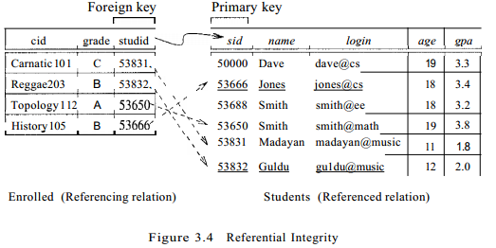
Foreign Key Constraints
CREATE TABLE Enrolled (
studid CHAR(20) ,
cid CHAR(20),
grade CHAR(10),
PRIMARY KEY (studid, cid),
FOREIGN KEY (studid) REFERENCES Students);

Slide 9
Enforcing Referential Integrity
Consider Students and Enrolled; sid in Enrolled is a foreign key that references Students
What should be done if an Enrolled tuple with a non-existent student id is inserted? (Reject it!)
What should be done if a Students tuple is deleted?
  Also delete all Enrolled tuples that refer to it.
  Disallow deletion of a Students tuple that is referred to.
  Set sid in Enrolled tuples that refer to it to a default sid.
  (In SQL, also: Set sid in Enrolled tuples that refer to it to a special value null, denoting `unknown’ or `inapplicable’.)
Similar if primary key of Students tuple is updated

Slide 10
Referential Integrity in SQL
Default is NO ACTION (delete/update is rejected)
CASCADE (also delete all tuples that refer to deleted tuple)
SET NULL / SET DEFAULT (sets foreign key value of referencing tuple)
CREATE TABLE Enrolled(
sid CHAR(20),
cid CHAR(20),
grade CHAR(2),
PRIMARY KEY (sid,cid),
FOREIGN KEY (sid)
REFERENCES Students
ON DELETE CASCADE
ON UPDATE SET DEFAULT )

Slide 11
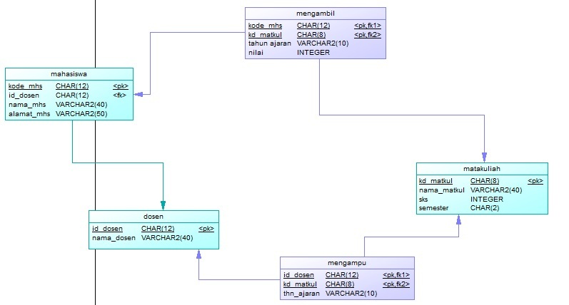
LATIHAN
Berdasarkan PDM tsb, tuliskan query dengan perintah CREATE TABLE untuk membuat tabel dosen, mata kuliah, dan mahasiswa

