Slide 1
Conceptual
Data Modelling
Rizka Hadiwiyanti, S.Kom, M.Kom, MBA

Slide 2
Example COMPANY Database
Requirements of the Company (oversimplified for illustrative purposes)
  The company is organized into DEPARTMENTs. Each department has a name, number and an employee who manages the department. We keep track of the start date of the department manager.
  Each department controls a number of PROJECTs. Each project has a name, number and is located at a single location.

Slide 3
Example COMPANY Database (Cont.)
  We store each EMPLOYEE’s social security number, address, salary, sex, and birthdate. Each employee works for one department but may work on several projects. We keep track of the number of hours per week that an employee currently works on each project. We also keep track of the direct supervisor of each employee.
  Each employee may have a number of DEPENDENTs. For each dependent, we keep track of their name, sex, birthdate, and relationship to employee.

Slide 4
The Entity-Relationship Model
Entity-Relationship model merupakan sekumpulan konsep dan simbol grafis yang dapat digunakan untuk merepresentasikan fakta dari ‘dunia nyata’
Four versions
  Original E-R model by Peter Chen (1976)
  Extended E-R model: the most widely used model
  Information Engineering (IE) by James Martin (1990)
  IDEF1X national standard by the National Institute of Standards and Technology
  Unified Modeling Language (UML) supporting
  object-oriented methodology

Slide 5
ER Model Concepts
Entities and Attributes
  Entities are specific objects or things in the mini-world that are represented in the database. For example the EMPLOYEE John Smith, the Research DEPARTMENT, the ProductX PROJECT
  Attributes are properties used to describe an entity. For example an EMPLOYEE entity may have a Name, SSN, Address, Sex, BirthDate
  A specific entity will have a value for each of its attributes. For example a specific employee entity may have Name='John Smith', SSN='123456789', Address ='731, Fondren, Houston, TX', Sex='M', BirthDate='09-JAN-55‘
  Each attribute has a value set (or data type) associated with it – e.g. integer, string, subrange, enumerated type, …

Slide 6
Entitas
sesuatu yang dapat diidentifikasi dalam lingkungan kerja user
Objek dalam dunia nyata yang dapat dibedakan dari objek lain
Entitas dapat berupa orang, benda, tempat, kejadian, konsep
Contoh:
  Orang: MAHASISWA, DOSEN, PEMASOK, PENJUAL
  Benda: MOBIL, MESIN, RUANGAN
  Tempat: NEGARA, DESA
  Kejadian: PENJUALAN, REGISTRASI
  Konsep: REKENING, KURSUS

Slide 7
Atribut
Setiap entitas memiliki atribut untuk mendeskripsikan karakteristik dari entitas tersebut
Contoh:
  Mahasiswa = (NPM, Nama_Mhs, Alamat, Email)
  Mobil = (Kode_Mobil, Merk_Mobil, Warna)
Setiap Entitas mempunyai atribut utama (primary key) yang dalam diagram ER dituliskan dengan diberi garis bawah

Slide 8
Notasi dalam Diagram ER
Pelanggan
Entitas
Atribut
Relasi
Penghubung
nama
mempunyai

Slide 9
Types of Attributes (1)
Simple
  Each entity has a single atomic value for the attribute. For example, SSN or Sex.
Composite
  The attribute may be composed of several components. For example, Address (Apt#, House#, Street, City, State, ZipCode, Country) or Name (FirstName, MiddleName, LastName). Composition may form a hierarchy where some components are themselves composite.
Multi-valued
  An entity may have multiple values for that attribute. For example, Color of a CAR or PreviousDegrees of a STUDENT. Denoted as {Color} or {PreviousDegrees}.

Slide 10
Types of Attributes (2)
Atribut tersimpan dan atribut turunan (derived attribute)
  Atribut tersimpan adalah atribut yang secara eksplisit tersimpan dalam database
  Atribut turunan adalah atribut yang nilainya dapat dikalkulasi dari nilai atribut tersimpan
  Contoh:
    Lama_Bekerja dapat dihitung dari tgl mulai bekerja sampai tgl hari ini
    Usia bisa dihitung dari tgl lahir
Some attributes (such as age) have values that constantly change. These are called volatile attributes.
Other attributes (such as order date) will rarely change, if ever. These are nonvolatile attributes.

Slide 11
Types of Attributes (3)
Some attributes must contain a value—these are mandatory attributes.
  For example: in most businesses that track personal information, name is required.
Others attributes may either contain a value or be left null—these are optional attributes.
  For example: cell phone number is often optional except in mobile or wireless applications.
  Email address could be a mandatory attribute for EMPLOYEE in an email application, but an optional attribute for CUSTOMER in an online catalog.

Slide 12
Entity Types and Key Attributes
Entities with the same basic attributes are grouped or typed into an entity type.
  For example, the EMPLOYEE entity type or the PROJECT entity type.
An attribute of an entity type for which each entity must have a unique value is called a key attribute of the entity type.
  For example, SSN of EMPLOYEE.
A key attribute may be composite. For example, VehicleTagNumber is a key of the CAR entity type with components (Number, State).
An entity type may have more than one key. For example, the CAR entity type may have two keys:
  VehicleIdentificationNumber (popularly called VIN) and
  VehicleTagNumber (Number, State), also known as license_plate number.

Slide 13
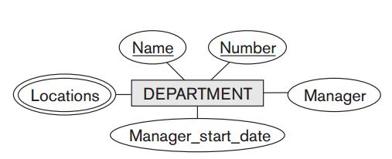
Initial Conceptual Design of the COMPANY Database
An entity type DEPARTMENT with attributes Name, Number, Locations, Manager, and Manager_start_date. Locations is the only multivalued attribute. We can specify that both Name and Number are (separate) key attributes because each was specified to be unique.

Slide 14
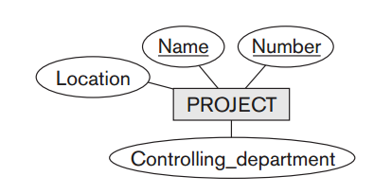
Initial Conceptual Design of the COMPANY Database
An entity type PROJECT with attributes Name, Number, Location, and Controlling_department. Both Name and Number are (separate) key attributes.

Slide 15
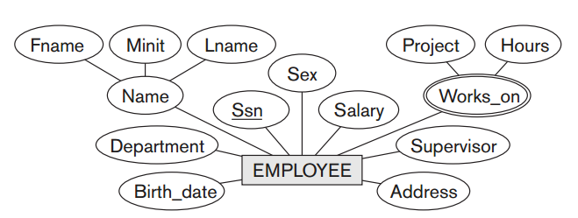
Initial Conceptual Design of the COMPANY Database
An entity type EMPLOYEE with attributes Name, Ssn, Sex, Address, Salary, Birth_date, Department, and Supervisor.
Both Name and Address may be composite attributes; however, this was not specified in the requirements.
We must go back to the users to see if any of them will refer to the individual components of Name—First_name, Middle_initial, Last_name—or of Address. In our example, Name is modeled as a composite attribute, whereas Address is not, presumably after consultation with the users.

Slide 16
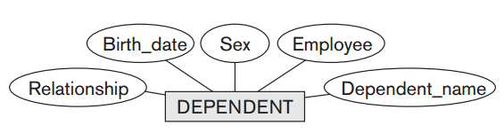
Initial Conceptual Design of the COMPANY Database
An entity type DEPENDENT with attributes Employee, Dependent_name, Sex, Birth_date, and Relationship (to the employee).

Slide 17
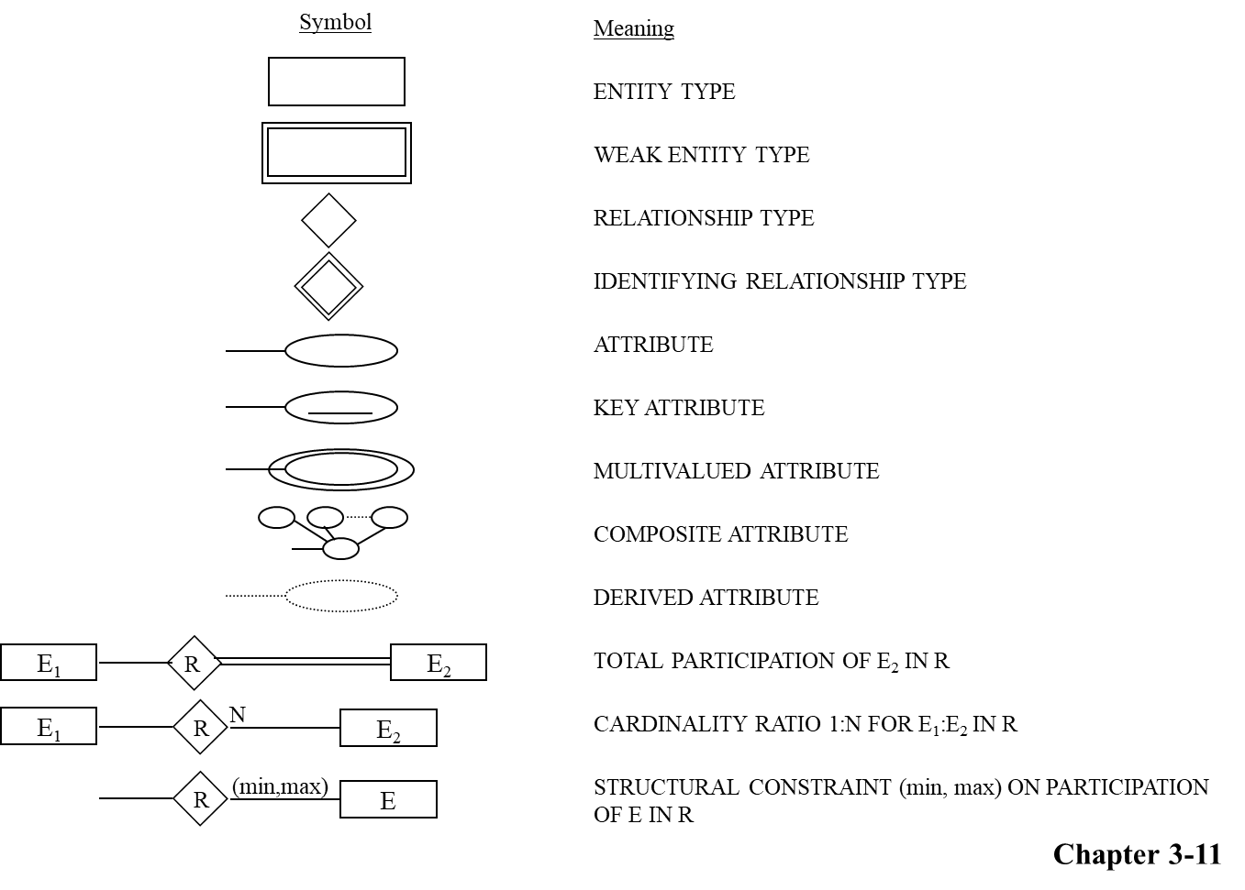
SUMMARY OF ER-DIAGRAM NOTATION FOR ER SCHEMAS

Slide 18
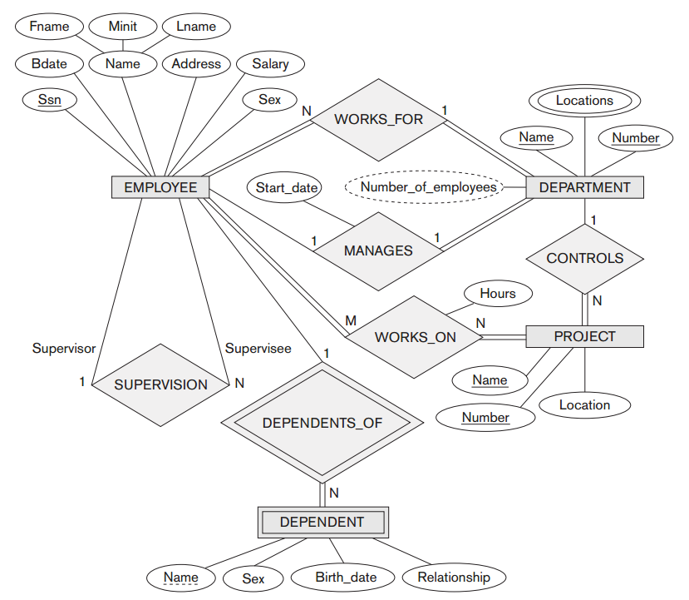
ER DIAGRAM
Entity Types are:
EMPLOYEE, DEPARTMENT, PROJECT, DEPENDENT

Slide 19
Relationships and Relationship Types (1)
A relationship relates two or more distinct entities with a specific meaning. For example, EMPLOYEE John Smith works on the ProductX PROJECT or EMPLOYEE Franklin Wong manages the Research DEPARTMENT.
Relationships of the same type are grouped or typed into a relationship type. For example, the WORKS_ON relationship type in which EMPLOYEEs and PROJECTs participate, or the MANAGES relationship type in which EMPLOYEEs and DEPARTMENTs participate.
The degree of a relationship type is the number of participating entity types. Both MANAGES and WORKS_ON are binary relationships.

Slide 20
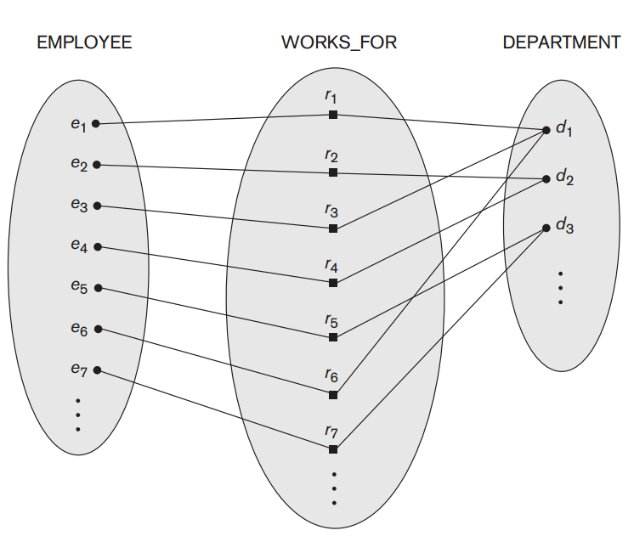
Example relationship instances of the WORKS_FOR relationship between EMPLOYEE and DEPARTMENT

Slide 21
Weak Entity Types
An entity that does not have a key attribute
A weak entity must participate in an identifying relationship type with an owner or identifying entity type
Entities are identified by the combination of:
  A partial key of the weak entity type
  The particular entity they are related to in the identifying entity type
Example:
Suppose that a DEPENDENT entity is identified by the dependent’s first name and birhtdate, and the specific EMPLOYEE that the dependent is related to. DEPENDENT is a weak entity type with EMPLOYEE as its identifying entity type via the identifying relationship type DEPENDENT_OF

Slide 22
Weak Entity Type is: DEPENDENT
Identifying Relationship is: DEPENDENTS_OF

Slide 23
Constraints on Relationships
Constraints on Relationship Types (Also known as ratio constraints )
Maximum Cardinality
  One-to-one (1:1)
  One-to-many (1:N) or Many-to-one (N:1)
  Many-to-many
Minimum Cardinality (also called participation constraint or existence dependency constraints)
  zero (optional participation, not existence-dependent)
  one or more (mandatory, existence-dependent)

Slide 24
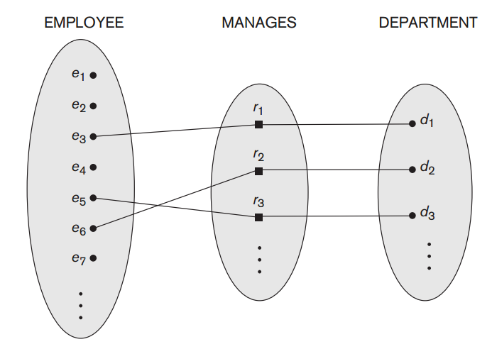
One-to-one (1:1) RELATIONSHIP

Slide 25
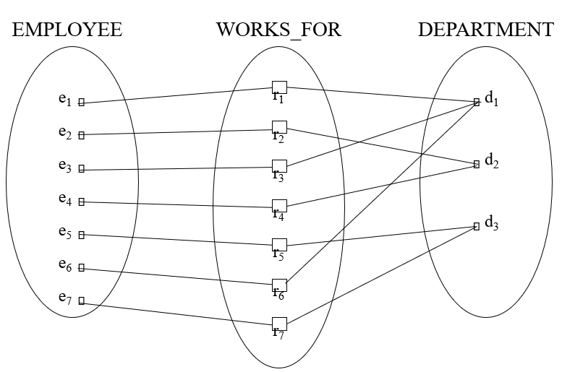
One-to-many (1:N) or Many-to-one (N:1) RELATIONSHIP

Slide 26
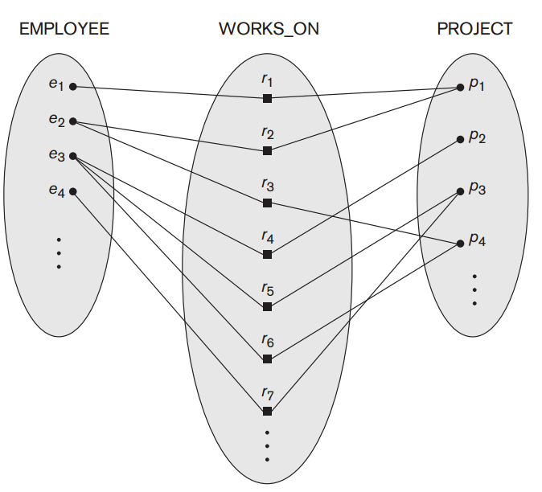
Many-to-many (M:N) RELATIONSHIP

Slide 27
Relationships and Relationship Types (2)
We can also have a recursive relationship type.
Both participations are same entity type in different roles.
For example, SUPERVISION relationships between EMPLOYEE (in role of supervisor or boss) and (another) EMPLOYEE (in role of subordinate or worker).
In ER diagram, need to display role names to distinguish participations.

Slide 28
Recursive Relationship Type is: SUPERVISION
(participation role names are shown)

Slide 29
Attributes of Relationship types
A relationship type can have attributes; for example, HoursPerWeek of WORKS_ON; its value for each relationship instance describes the number of hours per week that an EMPLOYEE works on a PROJECT.

Slide 30
Attribute of a Relationship Type is:
Hours of WORKS_ON

Slide 31
Structural Constraints – one way to express semantics of relationships
Structural constraints on relationships:
Cardinality ratio (of a binary relationship): 1:1, 1:N, N:1, or M:N
  SHOWN BY PLACING APPROPRIATE NUMBER ON THE LINK.
Participation constraint (on each participating entity type): total (called existence dependency) or partial.
SHOWN BY DOUBLE LINING THE LINK
NOTE: These are easy to specify for Binary Relationship Types.

Slide 32
Alternative (min, max) notation for relationship structural constraints:
Default (no constraint): min=0, max=n
Must have min ≤ max, min ≥ 0, max ≥ 1
Derived from the knowledge of mini-world constraints
Examples:
A department has exactly one manager and an employee can manage at most one department.
  Specify (0,1) for participation of EMPLOYEE in MANAGES
  Specify (1,1) for participation of DEPARTMENT in MANAGES
An employee can work for exactly one department but a department can have any number of employees.
  Specify (1,1) for participation of EMPLOYEE in WORKS_FOR
  Specify (0,n) for participation of DEPARTMENT in WORKS_FOR

Slide 33
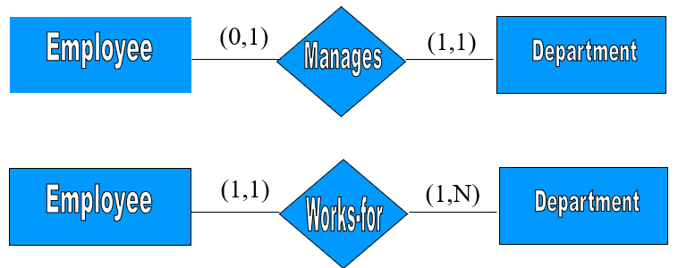
The (min,max) notation relationship constraints

Slide 34
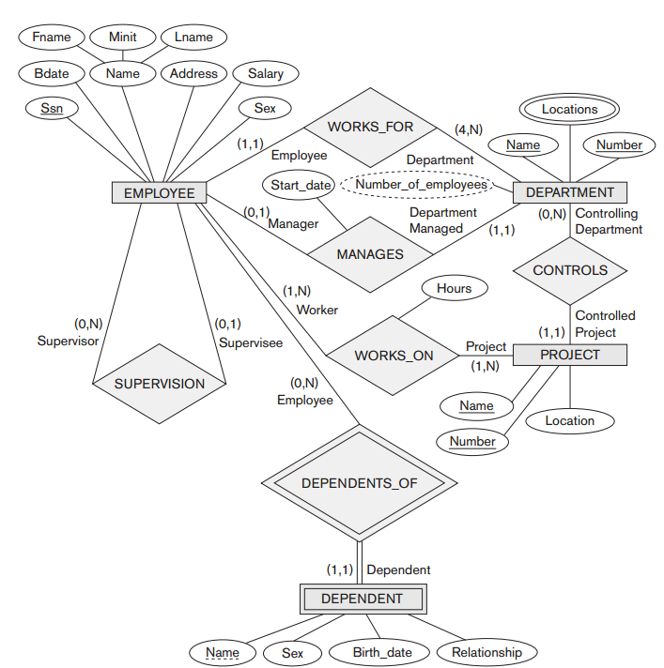
COMPANY ER Schema Diagram using (min, max) notation

