Slide 1
DATABASE MANAGEMENT SYSTEM (DBMS)
Rizka Hadiwiyanti, S.Kom, M.Kom, MBA

Slide 2
Data Model
Data Model: A set of concepts to describe the structure of a database, and certain constraints that the database should obey.
Data Model Operations: Operations for specifying database retrievals and updates by referring to the concepts of the data model. Operations on the data model may include basic operations and user-defined operations.

Slide 3
Categories of data models
Conceptual (high-level, semantic) data models: Provide concepts that are close to the way many users perceive data. (Also called entity-based or object-based data models.)
Physical (low-level, internal) data models: Provide concepts that describe details of how data is stored in the computer.
Implementation (representational) data models: Provide concepts that fall between the above two, balancing user views with some computer storage details.

Slide 4
Schemas versus Instances
Database Schema: The description of a database. Includes descriptions of the database structure and the constraints that should hold on the database.
Schema Diagram: A diagrammatic display of (some aspects of) a database schema.
Schema Construct: A component of the schema or an object within the schema, e.g., STUDENT, COURSE.
Database Instance: The actual data stored in a database at a particular moment in time. Also called database state (or occurrence).

Slide 5
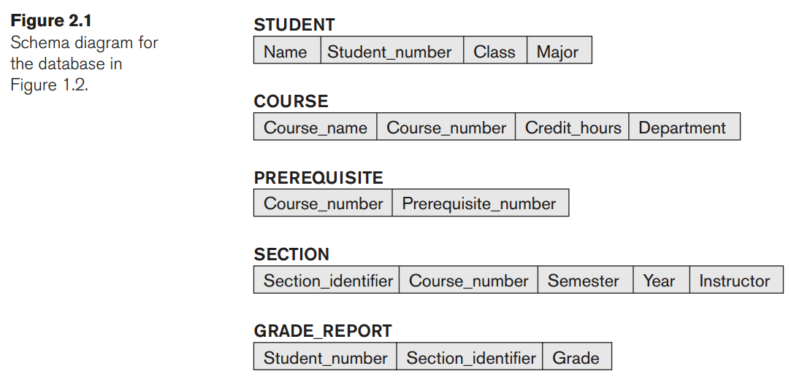
schema diagram

Slide 6
Database Management System (DBMS)
A software system that enables users to define, create, maintain, and control access to the database.
a DBMS provides the following facilities:
  It allows users to define the database, usually through a Data Definition Language (DDL). The DDL allows users to specify the data types and structures and the constraints on the data to be stored in the database
  It allows users to insert, update, delete, and retrieve data from the database, usually through a Data Manipulation Language (DML)
  It provides controlled access to the database (a security system, an integrity system, a concurrency control system, a recovery control system, and a user-accessible catalog)

Slide 7
(Database) Application Programs
A computer program that interacts with the database by issuing an appropriate request (typically an SQL statement) to the DBMS
  Users interact with the database through a number of application programs that are used to create and maintain the database and to generate information
  The application programs may be written in a programming language or in higher-level fourth-generation language

Slide 8
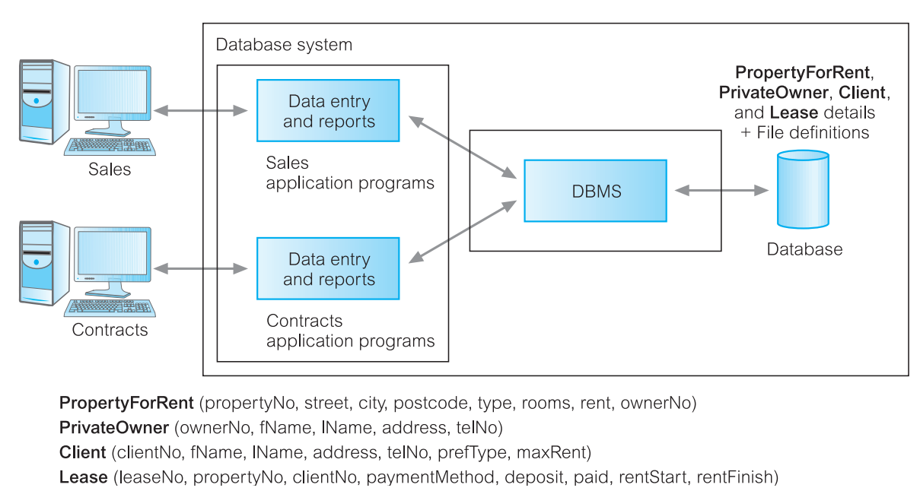
Database processing

Slide 9
Views
end-users are not too interested in how complex or easy a task is for the system
DBMS provides another facility known as a view mechanism, which allows each user to have his or her own view of the database
  For example, we could set up a view that allows the Contracts Department to see only the data that they want to see for rental properties

Slide 10
Views-Benefit
Reduce Complexity
Provide a level of security
Provide a mechanism to customize the appearance of the database
Present a consistent, unchanging picture of the structure of the database, even if the underlying database is changed

Slide 11
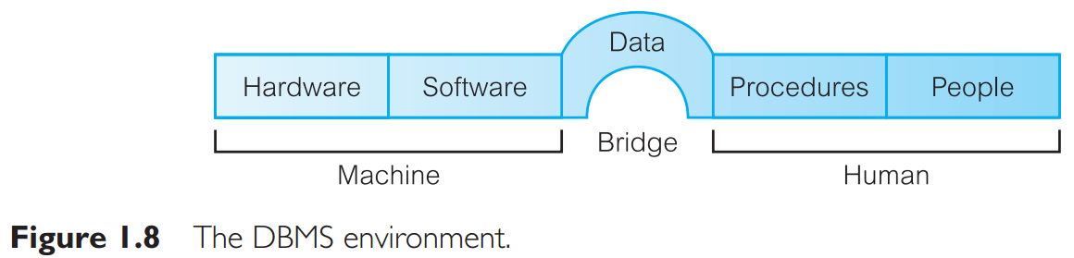
Components of the DBMS Environment

Slide 12
Hardware
The hardware can range from a single personal computer to a single mainframe or a network of computers
The particular hardware depends on the organization’s requirements and the DBMS used
  Some DBMSs run only on particular hardware or operating systems, while others run on a wide variety of hardware and operating systems

Slide 13
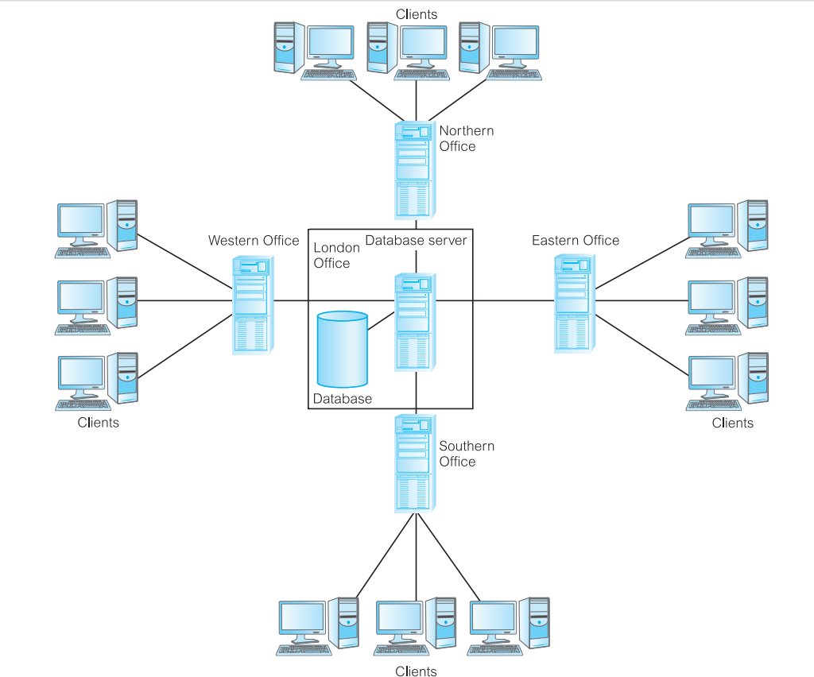
This is called a client–server architecture:
the backend is the server
the frontends are the clients

Slide 14
Software
The software component comprises the DBMS software itself and the application programs, together with the operating system, including network software if the DBMS is being used over a network

Slide 15
Data
data acts as a bridge between the machine components and the human components
The database contains both the operational data and the metadata, the “data about data.”
The structure of the database is called the schema

Slide 16
Procedure
Procedures refer to the instructions and rules that govern the design and use of the database
may consist of instructions on how to:
  Log on to the DBMS
  Use a particular DBMS facility or application program
  Start and stop the DBMS
  Make backup copies of the database
  Handle hardware or software failures
  Change the structure of a table, reorganize the database across multiple disks, improve performance, or archive data to secondary storage

Slide 17
People
Data administrators (DA): responsible for the management of the data resource
  Database planning
  development and maintenance of standards, policies and procedures
Database administrators (DBA):
  physical realization of the database
  physical database design and implementation,
  security and integrity control,
  maintenance of the operational system,
  ensuring satisfactory performance of the applications for users

Slide 18
People (cont’d)
database designers: logical database designers and physical database designers
logical database designers: concerned with identifying the data (entities and attributes), the relationships between the data, and the constraints on the data that is to be stored in the database
must have a thorough and complete understanding of the organization’s data and any constraints on this data (the constraints are sometimes called business rules)
Examples: a member of staff cannot manage more than 100 properties for rent or sale at the same time; member of staff cannot handle the sale or rent of his or her own property;

Slide 19
People (cont’d)
physical database designer decides how the logical database design is to be physically realized
  mapping the logical database design into a set of tables and integrity constraints
  selecting specific storage structures and access methods for the data to achieve good performance
application developers:
  Once the database has been implemented, the application programs that provide the required functionality for the end-users must be implemented
end-users
  Naïve users: do not need to know anything about the database or the DBMS
  Sophisticated users: familiar with the structure of the database and the facilities offered by the DBMS

Slide 20
Referensi
Connolly, Thomas dan Begg, Carolyn. Database Systems: A Practical Approach to Design, Implementation, and Management 6th edition. Pearson. 2015.
Elmasri, Navathe. Fundamental of Database Systems 7th edition. Pearson. 2016

