Slide 1

SRS / SKPL: Software Requirements Specification
PRA-UTS · PENDEKATAN TERSTRUKTUR
Information Systems Analysis and Design

Slide 2
What is an SRS (SKPL) and why does it matter?
DEFINITION
Shared agreement
1
Client, analyst, and developers work from the same reference.
An SRS is a formal document that describes WHAT a system must do and the constraints it works under, not HOW it is built.
Basis for design and testing
2
The design document and test cases are derived from it.
Controls cost of change
3
Known in Indonesia as SKPL (IEEE 830 / ISO 29148)
Wrong requirements cost the most when found late.

Slide 3
Where the SRS fits in the development cycle
Requirements
Analysis
SRS
(SKPL)
Design
(DPPL)
Implementation
Testing
›
›
›
›
Interviews, observation, surveys
WHAT is needed
HOW it is built
Coding per design
Verified against SRS
The SRS bridges user needs and technical design. Testers also use it as the yardstick: the system is correct when it meets the SRS.

Slide 4
Structure of an SRS document
1
Introduction
5
Non-Functional Requirements
Purpose, scope, definitions, references
Performance, security, availability
2
Overall Description
6
Data Requirements
Perspective, functions, users, constraints
ERD and data dictionary
3
External Interfaces
7
Traceability Matrix
UI, hardware, software, communication
Requirement to use case to test case
Functional Requirements
Appendices: mockups, interview results, open issues
4
Requirement list, use cases or DFD

Slide 5
Functional vs non-functional requirements
Functional
Non-Functional
What the system does
How well the system works
Examples:
Examples:
The system shall allow users to log in
A student shall be able to borrow a book
An admin shall be able to print reports
Response time ≤ 3 seconds
Passwords stored hashed
Availability ≥ 99% per month

Slide 6
Modeling approaches: Use Case vs DFD
SKPL Section | Use Case Approach | DFD Approach
2.1 Perspective | Context / architecture sketch | Context diagram (DFD Level 0)
4.2 Functional model | Use case diagram | DFD Level 1 (Level 2 if complex)
4.3 Functional detail | Use case description | Process specification (PSPEC)
4.4 Supporting models | Activity / sequence diagram | Flowchart, decision table, structured English
6 Data requirements | ERD + data dictionary | ERD + data dictionary (incl. flows and stores)
DFD rules: keep levels balanced, number processes hierarchically (1.0, 1.1), and trace each requirement to a process number.

Slide 7
Worked example: DFD of the library system
Student
LEVEL 1 PROCESSES
1.0 Manage Members
2.0 Process Loans
3.0 Search Catalog
4.0 Generate Reports
Search query,
loan request
Book info,
loan receipt
0
Library
Information System
DATA STORES
Book data,
member data
Reports,
fines list
D1 Books
D2 Members
D3 Loans
Librarian

Slide 8
Qualities of a good requirement
Clear and unambiguous
Measurable (numbers or criteria)
Testable
Consistent, no conflicts
Unique ID (traceable)
BAD
"The system must be fast and easy to use."
GOOD
"SRS-NF-001: The system shall return book search results in ≤ 2 seconds for 500 concurrent users."

Slide 9
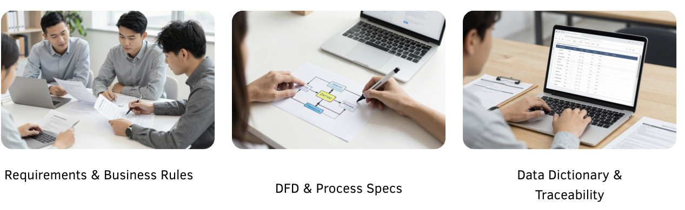
Workshop: Build Your SRS/SKPL
Develop an SRS Based on the Case Study
Use the analysis results from the previous meeting to develop a complete SRS draft according to the required format.

