Slide 1
Statistik Komputasi
02 - Research Design
Tim Dosen Statkom
Sistem Informasi
2025

Slide 2
01
What

Slide 3
blue print for the collection, measurement and analysis of data (Philips)
the plan, structure and strategy and strategy of investigation conceived so as to obtain answers to research questions and to control variance (Kerlinger)
types of inquiry within qualitative, quantitative, and mixed methods approaches that provide specific direction for procedures in a research study (Creswell & Creswell)
many more definitions from other researchers ……….

Slide 4
“how” to conduct research using a particular methodology
Describe the following :
the type of study (such as qualitative, quantitative, or mixed methods)
the sampling technique
data collection methods
data analysis procedures
ethical consideration

Slide 5
Why??
02

Slide 6
01
02
03
04
Define research objective&purpose
Enhance validity and reliability
ensure that the research is focused
Increase the validity and reliability of the findings
Helps identify potential problem
Facilitates comunication and replication
Identify and mitigate the problem in advance
Easier to understand and replicate the study

Slide 7
When??
03

Slide 8
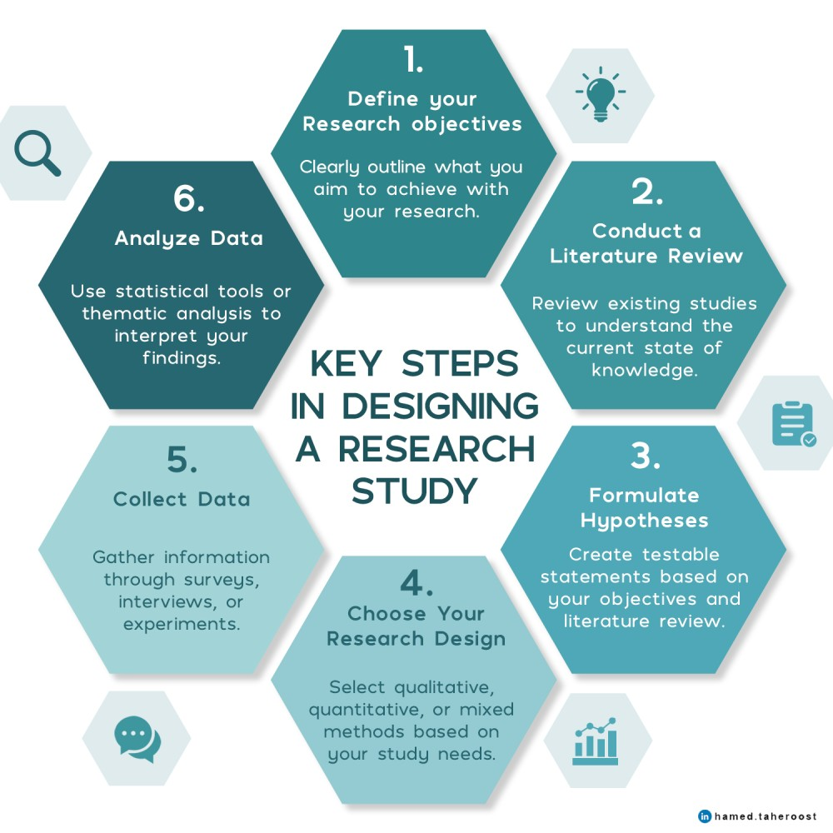

Slide 9
The concepts in research design

Slide 10
Construct
Measurement
the thing that you’re trying to take a measurement of
Ex : “age”, “gender” or an “opinion”
assigning numbers, or labels, or some other kind of well-defined descriptions to “stuff”
Variable
Measure
method or the tool that you use to make your observations
Ex : A question in a survey, a behavioural observation
the outcome of a psychological measurement
types of variables 🡪 measurement scale
Notes:
measure something about human behaviour or the human mind

Slide 11
Type of Variable I
Predictor
variables
Dependent
Variables (DV)
Independent
Variables (IV)
depend on the independent variables
outcomes or results of the influence of the independent variables
used to predict an outcome
similar to IV – affect outcomes
But dissimilar because can’t manipulated
Influence/affect outcomes
manipulated in an experiment

Slide 12
Intervening /
mediating variables
Moderating
variables
stand between the independent and dependent variables
transmit the effect of an independent variable on a dependent variable
predictor variables that affect the direction and/or the strength of the relationship between independent and dependent variable

Slide 13
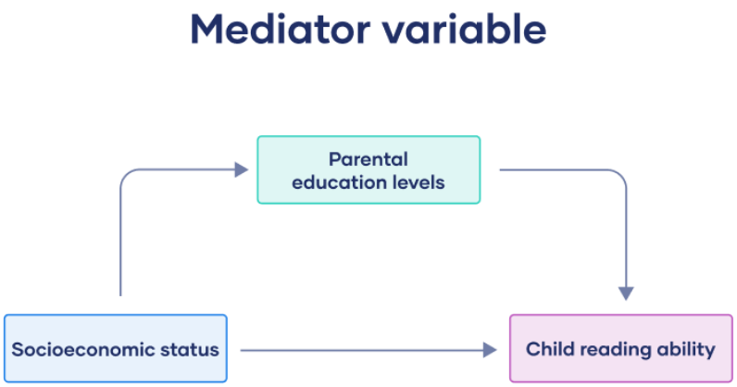
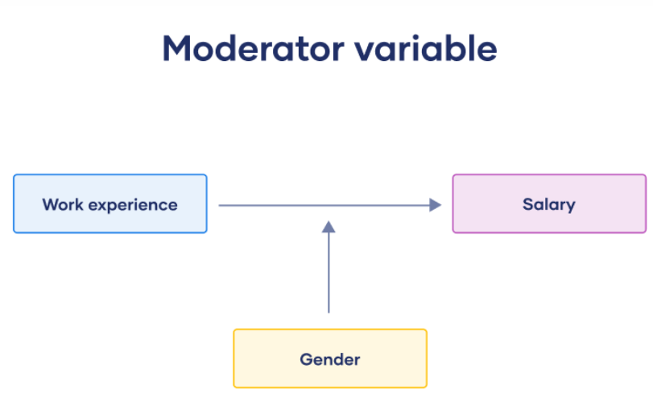
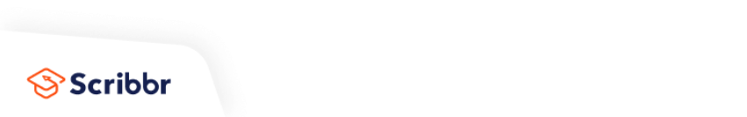

Slide 14
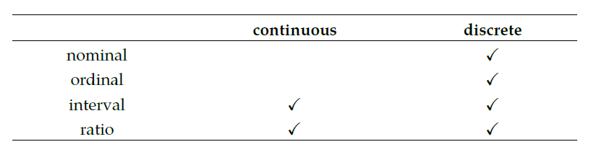
Type of Variable II
continuous variable : for any two values that you can think of, it’s always logically possible to have another value in between
Ex : response times in 3.1 seconds
discrete variable : a variable that isn’t continuous. For a discrete variable it’s sometimes the case that there’s nothing in the middle
Ex: type of transportation 🡪 train or car

Slide 15
Ordinal scale
Nominal/
categorical scale
Data has order
Ex : education level
Data has no order
Ex: f/m; train/bus/car/bicycle
Interval scale
Ratio scale
data has order
each data has the same difference
has true zero
Addition, subtraction, multiplication and division
Ex : response time
data has order
each data has the same difference
does not have true zero
addition and subtraction
Ex : temperature in degrees celsius

Slide 16
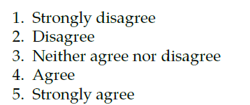
Exercise 1
Likert scale
ordinal scale, interval scale or other scale?

Slide 17
04
HOW

Slide 18
Qualitative
Survey study
Quantitative
Experimental study
Research design
Convergent
Explanatory sequential
Mixed method
Exploratory sequential
Complex

Slide 19
STEP in Survey Study
Survey Design
Population and Sample
Instrumentation
Data Analysis

Slide 20
Survey Design
Identify the purpose of survey research
Indicate whether the survey will be cross-sectional (data collected at one point in time) or longitudinal (data collected over time)
Specify the form of data collection
Notes:
Blue font is the thing to be measured

Slide 21
Population and Sample
Identify the population in the study
Identify Sampling design (single stage vs multistage (clustering))
Identify type of sampling (random sample vs systematic sample vs nonprobability sample ) – the selection process for participants
Identify whether the study will involve stratification of the population before selecting the sample
Sample size determination
Notes:
Blue font is the thing to be measured

Slide 22
Instrumentation
Identify the survey instruments used to collect data (a modified instrument or an instrument developed by someone else)
Validity of scores using the instrument
Notes:
Blue font is the thing to be measured

Slide 23
Validity
Internal validity
External validity
Construct validity
the extent to which you are able to draw the correct conclusions about the causal relationships between variables
to what extent do you expect to see the same pattern of results in “real life” as you saw in your study
whether you’re measuring what you want to be measuring
good construct validity if it is actually measuring the correct theoretical construct
Notes:
Blue font is the thing to be measured

Slide 24
Validity
Face validity
Ecological validity
whether or not a measure “looks like” it’s doing what it’s supposed to
how close to the real world the research scenario being carried out is.
Notes:
Blue font is the thing to be measured

Slide 25
Threat to Validity
Repeated testing effects
History Effect
Maturation Effect
the possibility that specific events may occur during the study that might influence the outcome measure
relate to how people change on their own over time.
not a response to a specific event
if the first measurement has an effect on the second measurement
Notes:
Blue font is the thing to be measured

Slide 26
Threat to Validity
Selection bias
Differential attrition
Non-response bias
the people “selected into” the two groups have different characteristics
the attrition effect is different for different groups.
Non response – missing data
OK If the missing data was “lost” randomly,
Big problem If it’s missing systematically
Notes:
Blue font is the thing to be measured

Slide 27
Threat to Validity
Regression to the mean
Experimenter bias
Demand effects and reactivity
the experimenter can accidentally end up influencing the results of the experiment by subtly communicating the “right answer” or the “desired behaviour” to the participants
situation where you select data based on an extreme value on some measure.
people alter their performance because of the attention that the study focuses on them
Participant knew they were being studied
Notes:
Blue font is the thing to be measured

Slide 28
Threat to Validity
Fraud, deception and self-deception
Situation, measurement and sub-population effects
Placebo effects
the fact of being treated causes an improvement in outcomes
Data fabrication
Data misrepresentation
Study “misdesign”
Data mining and post hoc hypothesising
Publication bias and self-censoring
all other threats to external validity influencing the results
Notes:
Blue font is the thing to be measured

Slide 29
Instrumentation
3. Reliability of scores on the instrument
4. Administering the survey
Notes:
Blue font is the thing to be measured

Slide 30
Data Analys
Descriptive analysis
Reliability checks
Identify the statistical test to answer the research question or hypothesis
Present the results in tables or figures
Interpret the results from the statistical test
Notes:
Blue font is the thing to be measured

Slide 31
STEP in Experimental Study
Participants
Variables
Instrumentation and Materials
Experimental Procedures

Slide 32
Participants
Identify :
Selection of participants
Assignment of participants
Number of participants
inclusion and exclusion criterion
Notes:
Blue font is the thing to be measured

Slide 33
Variables
Identify :
Independent variables
Dependent variable
Other variables to be measured in the study
Notes:
Blue font is the thing to be measured

Slide 34
Instrumentation and Materials
Identify instrument used in study, explain :
        The development
        The items
        The scales
        Reliability and validity of scores
Identify the approach for manipulating the independent variables of interest
Notes:
Blue font is the thing to be measured

Slide 35
Experimental Procedures
Identify the type of experimental design
Identify what is being compared in the experiment
Provide a diagram or a figure to illustrate the specific research design to be used
Notes:
Blue font is the thing to be measured

Slide 36
References
Creswell, J. W., Creswell, J. D. (2017). Research Design: Qualitative, Quantitative, and Mixed Methods Approaches. United Kingdom: SAGE Publications.
Navarro, D., & Foxcroft, D. (2025). Learning Statistics with jamovi: A Tutorial for Beginners in Statistical Analysis. 490. https://doi.org/10.11647/OBP.0333

Slide 37
ASSIGNMENT

Slide 38
PENYUSUNAN HIPOTESIS
Dikerjakan secara kelompok
Cari topik dengan tema smart village
Identifikasi variable nya
Rumuskan hipotesis nol dan hipotesis alternatif
Jelaskan Alasan Penyusunan Hipotesis (berdasarkan teori, literatur, atau observasi awal)
Tuliskan dalam bentuk laporan dan dikumpulkan dalam bentuk PDF melalui ilmu2, deadline pengerjaan 6 hari
Notes:
Blue font is the thing to be measured

Slide 39
Thanks!
Do you have any questions?
Please keep this slide for attribution

