Slide 1

Business & IT Alignment

Slide 2
Why Do IT Projects Fail?
Budget overrun
  Late delivery
  Not used by users
  Features mismatch
  No business impact

Slide 3
What is Business–IT Alignment?
The degree to which IT strategy, processes, and investments support and are supported by business strategy.
  IT follows business direction
  Business understands IT capability
  Shared goals and shared metrics

Slide 4
Why Alignment Matters
Without alignment:
  Wrong system development
  Budget waste
  Unclear KPI measurement
With alignment:
  Clear priorities
  Measurable value creation

Slide 5
The 3 Levels of Alignment
Operational Alignment – IT supports daily operations
Tactical Alignment – IT improves efficiency and processes
Strategic Alignment – IT drives competitive advantage

Slide 6
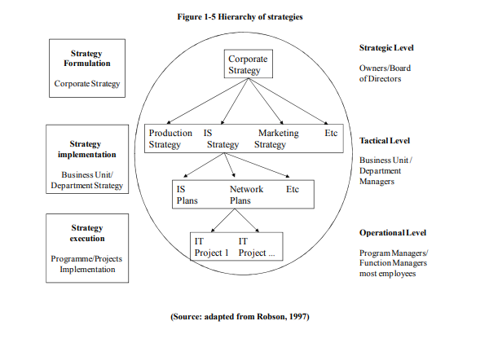

Slide 7
Operational Alignment
Characteristics: IT as support tool
  Examples: Payroll system, Inventory system
  Measurement: SLA, uptime, incident resolution time

Slide 8
Tactical Alignment
Characteristics: Process automation, decision support
  Examples: BI dashboard, CRM implementation
  Measurement: Cycle time reduction, process accuracy, user adoption

Slide 9
Strategic Alignment
Characteristics: IT as competitive advantage
  Examples: Platform business model, personalization engine
  Measurement: Revenue impact, market growth, retention rate

Slide 10
Business Strategy Types
Growth/Acquisition:
Perusahaan memiliki fokus pada pertumbuhan/perkembangan perusahaan (pendapatan)
Innovation/Differentiation:
Perusahaan memiliki fokus untuk menawarkan produk dan layanan yang berbeda dan/atau inovatif kepada klien mereka
Cost Leadership
Perusahaan memiliki fokus pada minimalisasi biaya jangka pendek
Client Service/Stability
Perusahaan ini memiliki fokus untuk menyediakan layanan yang stabil dan berorientasi pada klien.

Slide 11
Linking Business Strategy to IT Strategy
Cost Leadership
IT Focus → Automation, process efficiency, cost control
Differentiation
IT Focus → Innovation, digital experience, data-driven personalization
Growth Strategy
IT Focus → Scalability, analytics, flexible infrastructure
Client Service Excellence
IT Focus → System reliability, CRM integration, service responsiveness

Slide 12
Symptoms of Misalignment
IT KPI ≠ Business KPI
  Lack of communication
  IT seen only as cost center
  High spending, low impact

Slide 13
Case Discussion
Scenario:
A university implements a new academic information system.
System uptime = 99.9%
Students complain registration is confusing
Admin staff still use Excel manually
Rector says IT budget is too high

Slide 14
Summary
IT must support business goals
  Alignment determines what and how we measure
  IT performance = business contribution

