Slide 1
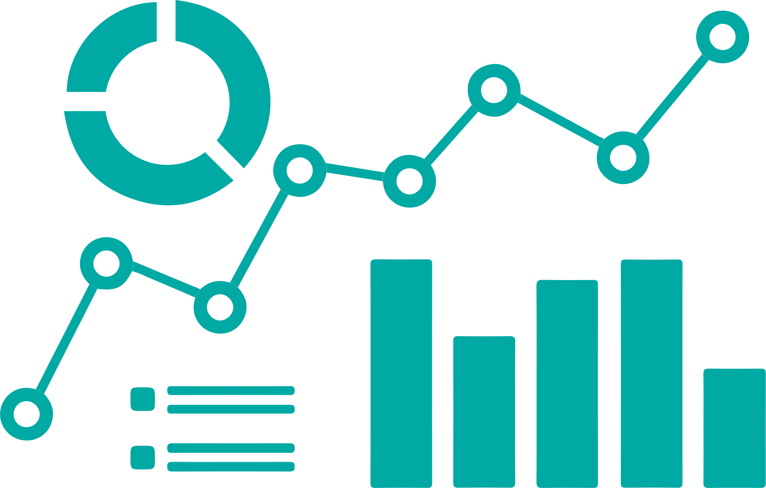
01
INTRODUCTION TO STATISTICS
Statkom Team Teaching

Slide 2

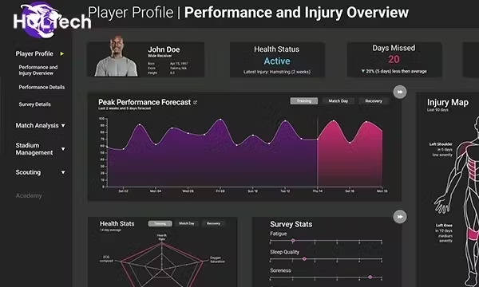
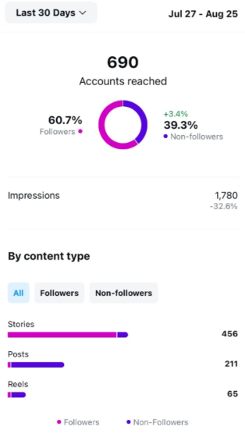


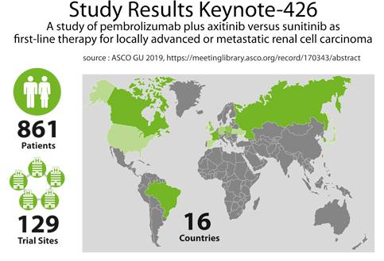
Statistics are everywhere
Statistics summarize raw facts and figures into meaningful information.

Slide 3



Key Steps in Statistics
Gather Data
Analyze
Draw Conclusion
Make predictions and decisions
From surveys, experiments, sources.
Organize, compute, and interpret results

Slide 4
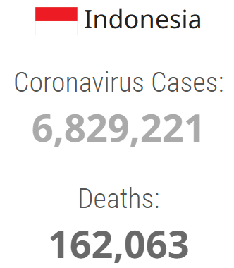
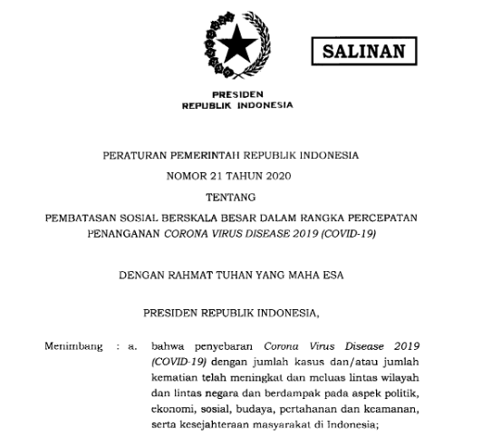
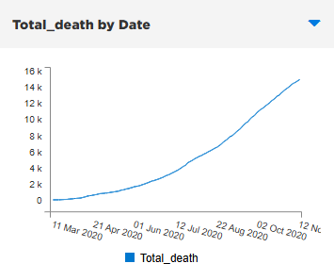
Key Steps in Statistics
Gather Data
Analyze
Draw Conclusion
Make predictions and decisions
From surveys, experiments, sources.
Organize, compute, and interpret results

Slide 5




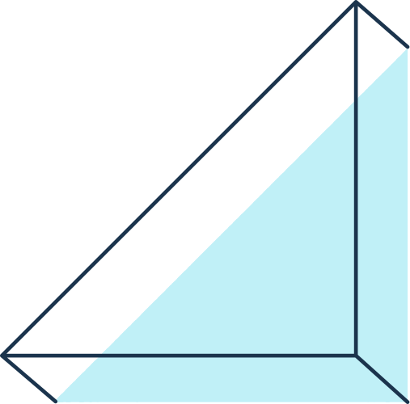
Why Learn Statistics?
  Empowers Decision-Making :
Turns intuition into evidence-based conclusions.
  Detects Misleading Data
Identifies cherry-picking, biased samples, or flawed methodologies.
  Same Data, Different Stories:
Manipulated axes, truncated scales, or selective timeframes.

Slide 6
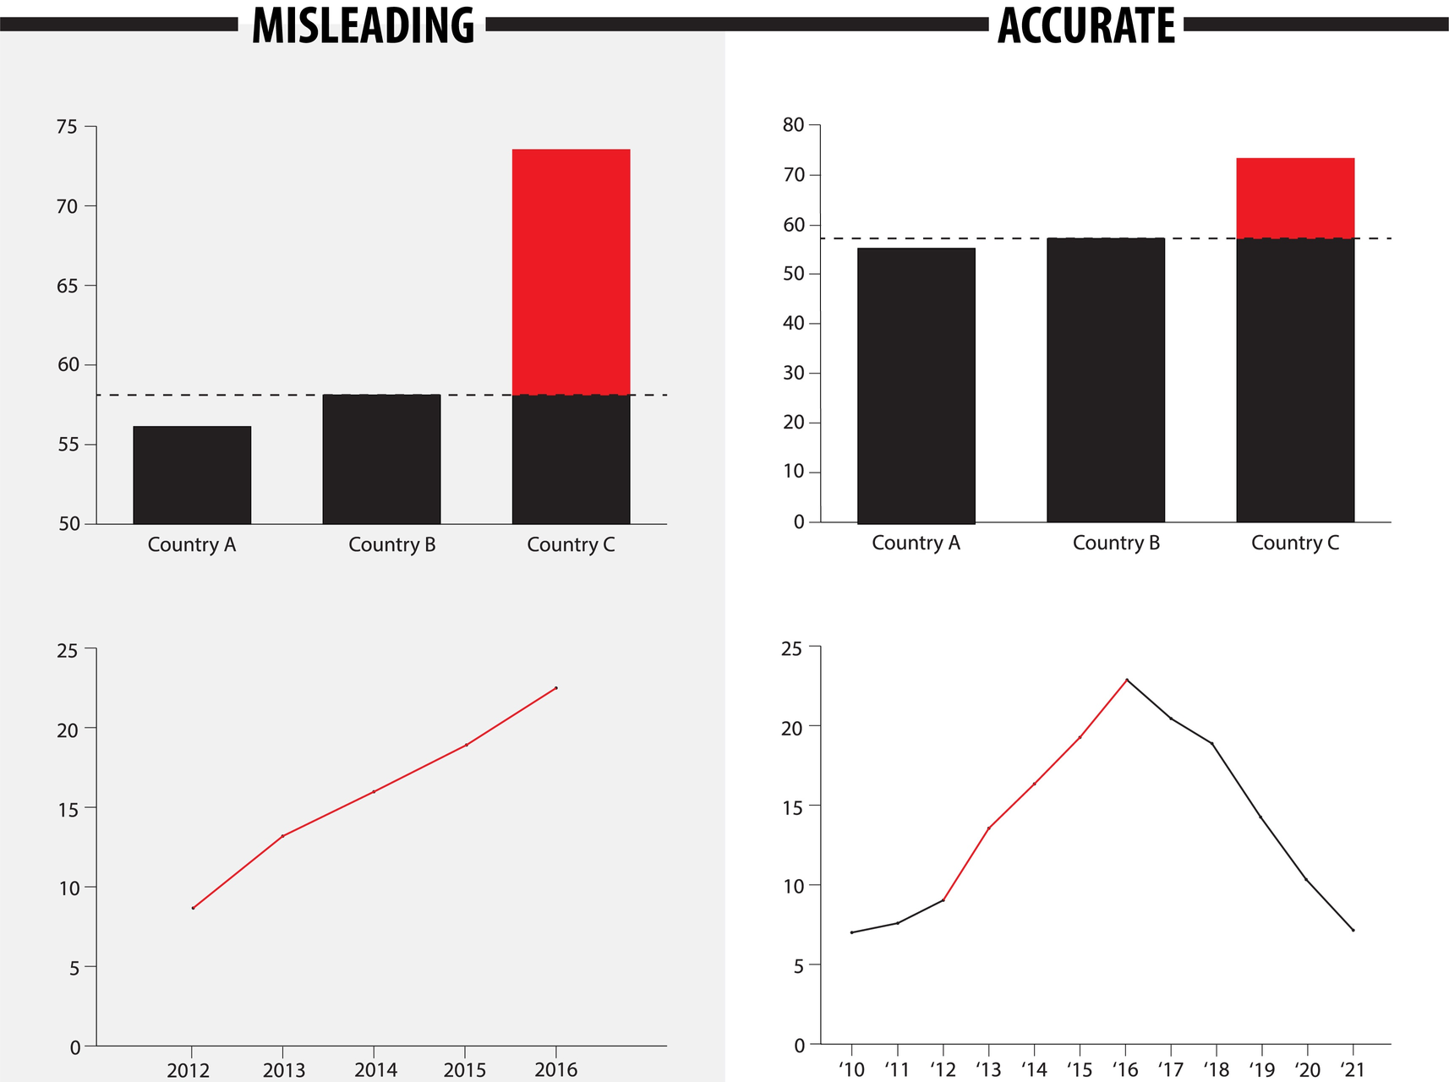
Notes:
https://www.universiteitleiden.nl/en/research/research-projects/science/using-factchecks-to-combat-misleading-graphs
https://www.geckoboard.com/best-practice/statistical-fallacies/

Slide 7

Why Scientists Use Statistics
(Not Just Common Sense)
  HUMANS ARE BIASED. WE BELIEVE WHAT WE WANT TO BELIEVE
  COMMON SENSE IS UNRELIABLE FOR ANALYZING COMPLEX DATA.
Example: During COVID-19, many believed "lockdowns don’t work" based on personal experience, but statistical analysis showed reduced transmission rates.

Slide 8
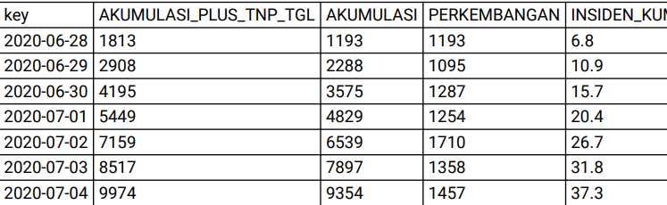
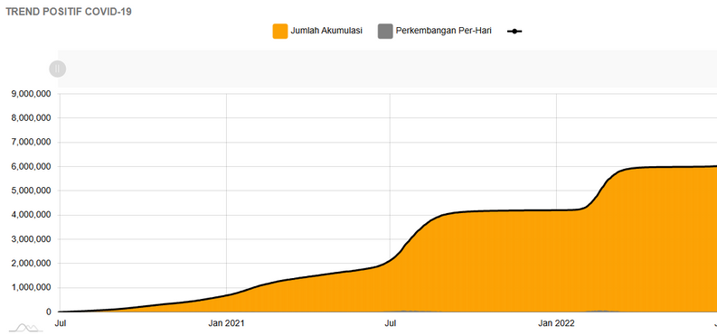

Data vs. Information
Case Study: COVID-19 Data to Public Health Policies
  Raw Data: Daily case counts (e.g., “March 2020: 100, 200, 500…”).
  Information: “7-day rolling average shows a 50% weekly increase in cases” → Triggers lockdowns.
Try converting the raw data below into information!
  Raw Data: “72, 85, 91, 68, 77” (exam scores).

Slide 9
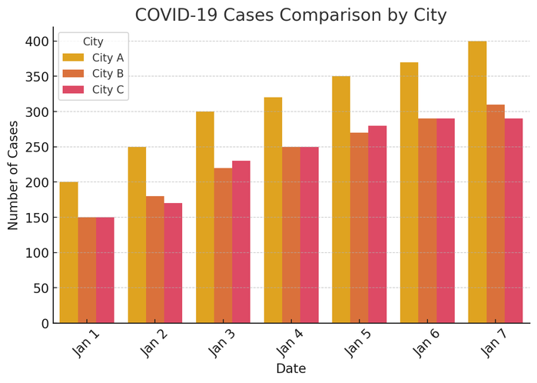
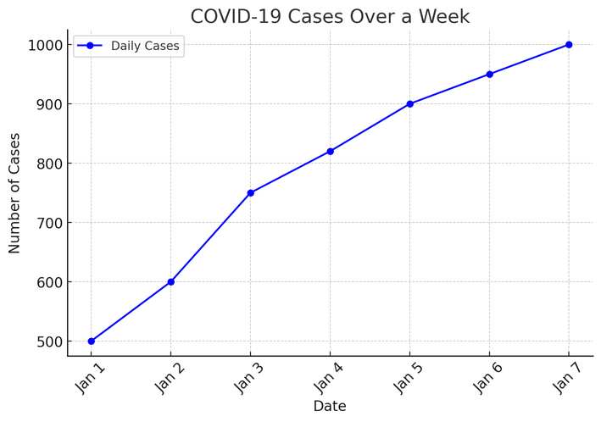
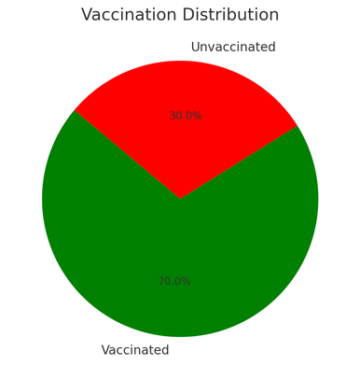
Why Use Charts for Data?
📌 Charts help visualize trends and patterns.
📌 Raw numbers are hard to interpret.
📌 Different charts emphasize different aspects of data.
Date | Cases
Jan 1 | 500
Jan 2 | 600
Jan 3 | 750
Jan 4 | 820
Jan 5 | 900
Jan 6 | 950

Slide 10

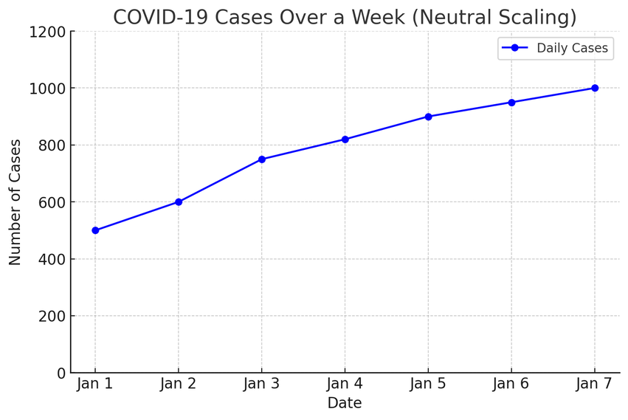
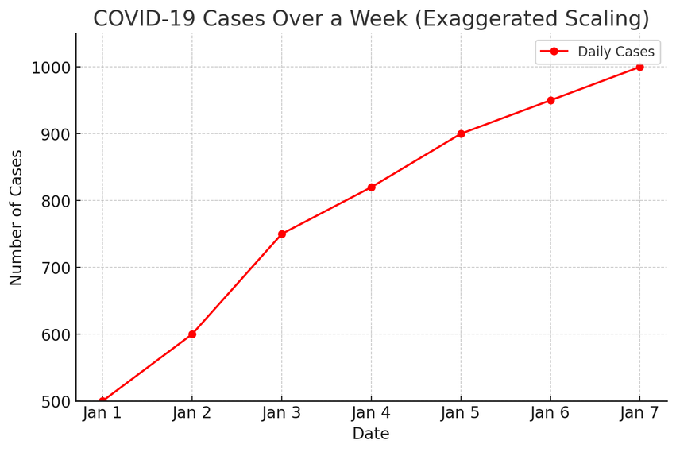
Misleading Graphs – A Tale of Two Charts
  Y-axis starts from 0, showing a gradual increase in COVID-19 cases over the week.
  The trend looks realistic, helping public health officials make informed decisions.
  Y-axis starts from 500 instead of 0, making the rise in cases appear more dramatic than it actually is.
  This can cause unnecessary panic or be used to push an agenda

Slide 11

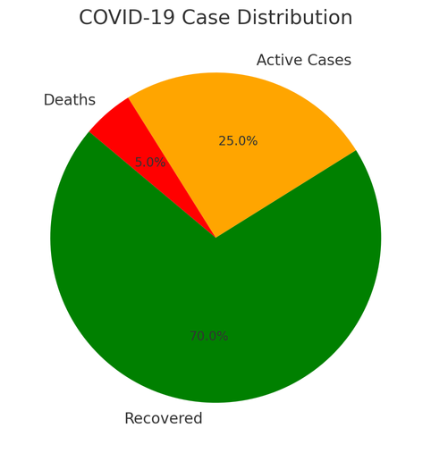
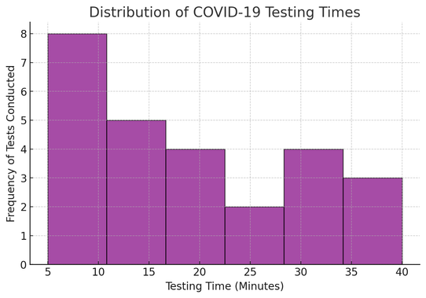
Types of Charts & When to Use Them
Histograms – Show distributions of numeric data
Pie Charts – Show proportions.
Bar Charts – Compare values
Line Charts – Show trends over time

Slide 12
Types of Charts & When to Use Them
✅ Good for: Showing proportions.
❌ Bad for: Data with small differences.
✅ Easier to compare differences.
❌ Not Good for Trends Over Time
✅ Time-based data (stock prices, temperature).
❌Not Ideal for Categories
✅ Works Well for Large Datasets
❌ Only Works for Numeric Data
❌ Doesn’t Show Individual Data Points

Slide 13




To Sum Up:
  Statistics make sense of data.
  Charts help visualize patterns.
  Not all charts are accurate—always check for misleading visuals.
  Choosing the right chart matters.

Slide 14




References
Griffiths, D. (2009). Head first statistics (1st ed.). O'Reilly Media.
Foxcroft, D. (2021). Learning Statistics with Jamovi.

